Slide 1
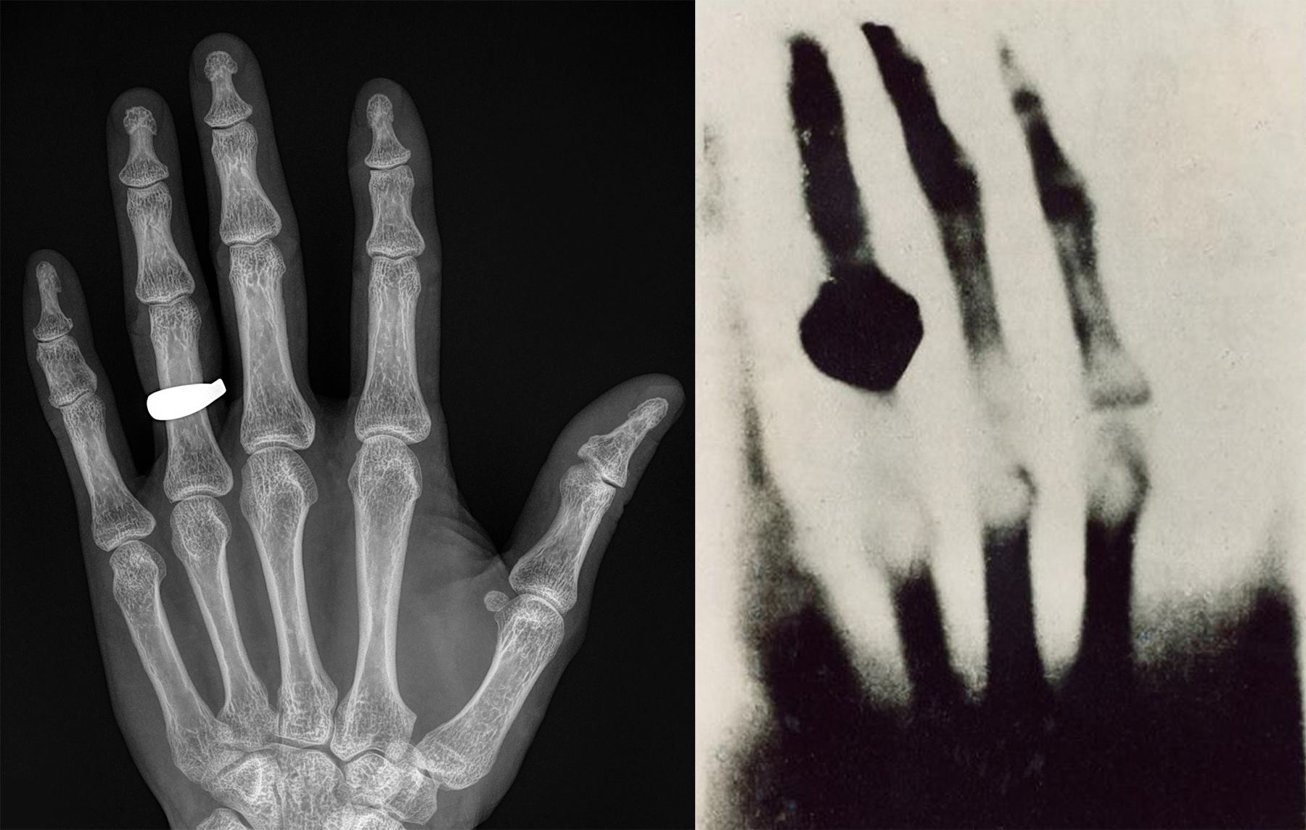
Diagnostic imaging a quick over or review
Dr. Candace Makeda Moore, MD
Notes:
this is 5min version of our 30min slidedeck :-)

Slide 2
Diagnostic imaging
X-rays and ultrasounds
Other radiology and nuclear medicine modalities
Pathology imaging
Emerging technologies in imaging and visualization
Why a diagnostic imaging lecture?

Slide 3
Why this and code?
Modern medical image related research is almost inherently multidisciplinary
In the end we have to talk to each other.
Let’s have a shared vocabulary

Slide 4
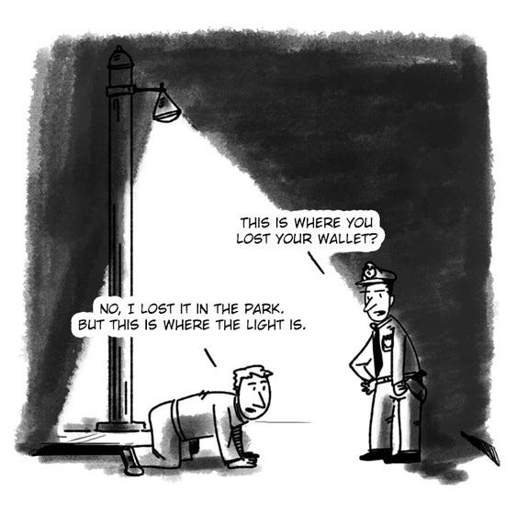
Diagnostic imaging
Basic idea when we mention different modalities
Which modality and anatomy is best for my question?
Can an imaging modality and sequence give data for my question?
What information is it giving?
Can we couple this with information from other modalities somehow?
What computational tools and algorithms will best analyze that information?
- file formats
- conventions
- image characteristics

Slide 5
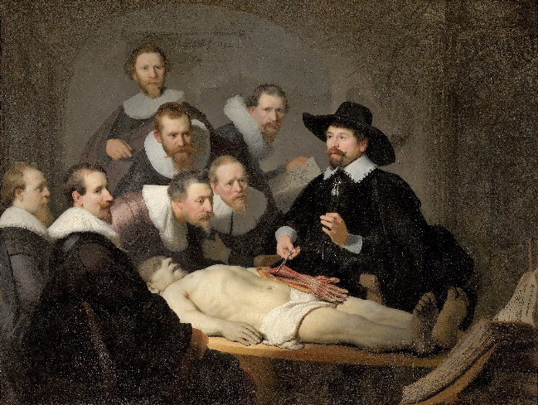
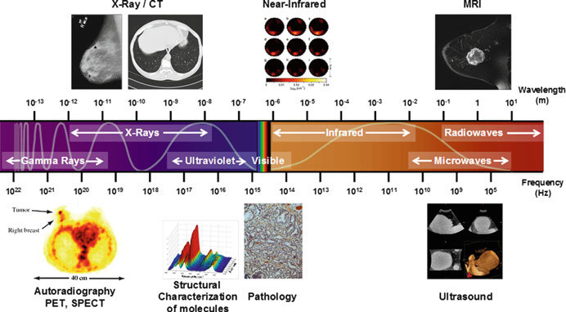
Diagnostic imaging
Anatomic divisions
Imaging technology divisions
Rembrant
Intes, Xavier & Venugopal, Vivek & Chen, Jin & Azar, Fred. (2012). Multimodal diffuse imaging system.
Special cases:
Mammography
Virtual colonoscopy
fMRI
Echocardiography
Angiography (CT or MR)
X-ray
CT
MRI
Ultrasound
PET+
Microscopy

Slide 6
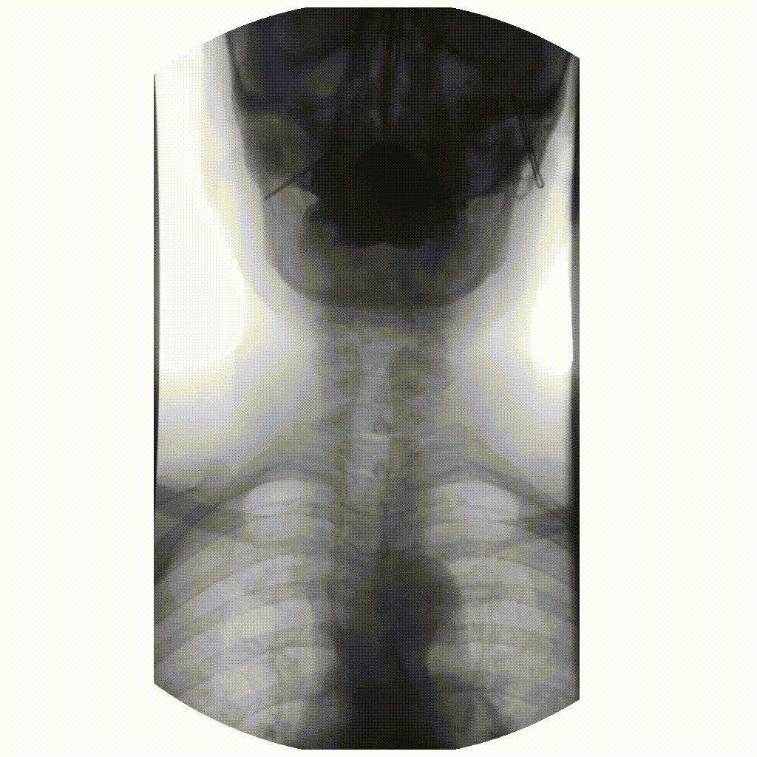
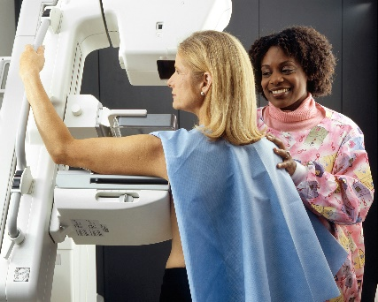

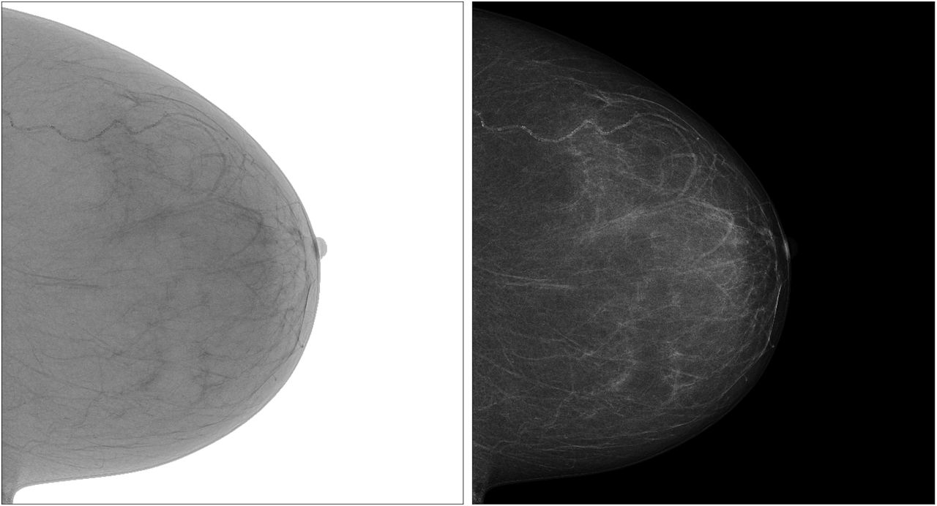
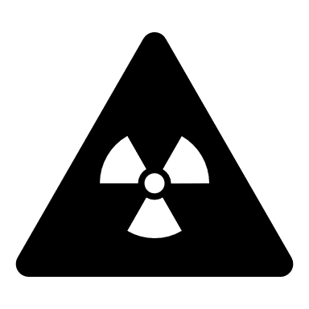
Diagnostic Imaging: Xrays
1895 Willem Roentgen : X rays
Today we have classical X-rays, mammography, DEXA and fluoroscopy and…
Radiographs are computationally → 2D arrays of pixels (jpeg 2000) + metadata (DICOM)
Modern sequence in fluoro video → (MPEG, HEVC) + metadata (DICOM)

Slide 7
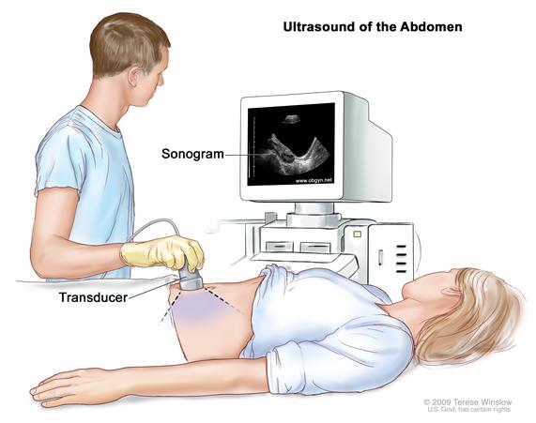
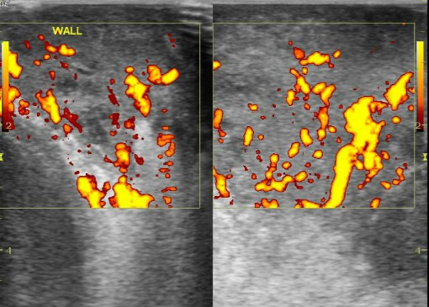
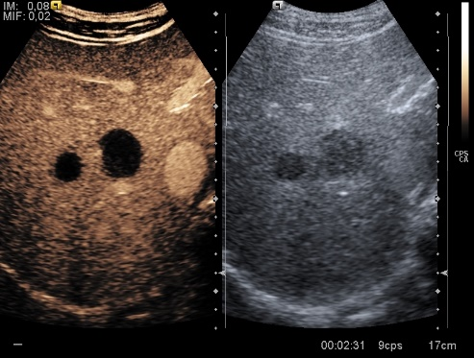
Diagnostic Imaging: US
1956 Ian Donald (uses 1D A-mode ultrasound in diagnosis)
2.5 – 10 megahertz: will both propagate and reflect back
Today most datasets will be B-mode, doppler, contrast enhanced, M-mode (echo, lung), 4D…
Computationally can be video/CINE or 2D arrays + metadata
Case courtesy of Maulik S Patel, Radiopaedia.org, rID: 30434
Case courtesy of Teresa Fontanilla, Radiopaedia.org, rID: 30925

Slide 8
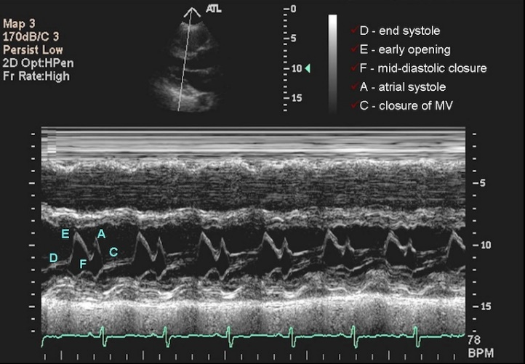
Diagnostic Imaging: US
Let’s
do
our
first
Exercise!

Slide 9
Diagnostic Imaging: US
Important for computational research
Disadvantages:
Highly operator dependent
Position and power will vary, maybe even with a specific protocol
Resolution is lower
Often with burned in stuff (protocol this away from research?)
Vendor/machine variability?
Advantages:
Modality that easily shows things at different angles and/or in motion
No radiation, low/no harm! Can be used on baby’s brains

Slide 10
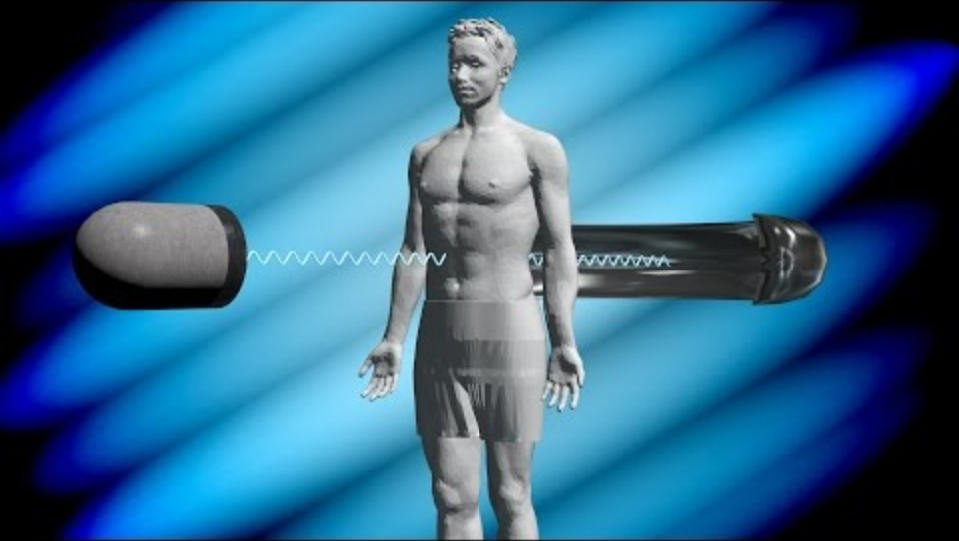
Diagnostic Imaging: CT and tomographic forms
1972: Godfrey Hounsfield (first CT)
Today nuclear medicine, CTs, tomosynthesis, other forms of tomography
Computationally 3D arrays of voxels with Hounsfield unit values + metadata (DICOM)

Slide 11
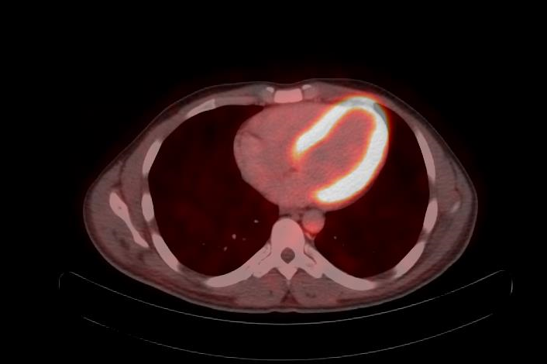
Diagnostic Imaging: tomographic forms
Nuclear Medicine
the signal is put inside you,
less anatomic precision
so often coupled with CT or MRI
PET = positron emission tomography
radioactive molecules (tracers) are put into patients, the tracers can be a molecule that indicates where something is consumed,
tracers give positrons off
Computationally 3D arrays + metadata (DICOM); HEAVY
18-FDG PET-CT (normal heart at work)
Case courtesy of Pir Abdul Ahad Aziz Qureshi, Radiopaedia.org, rID: 68166

Slide 12
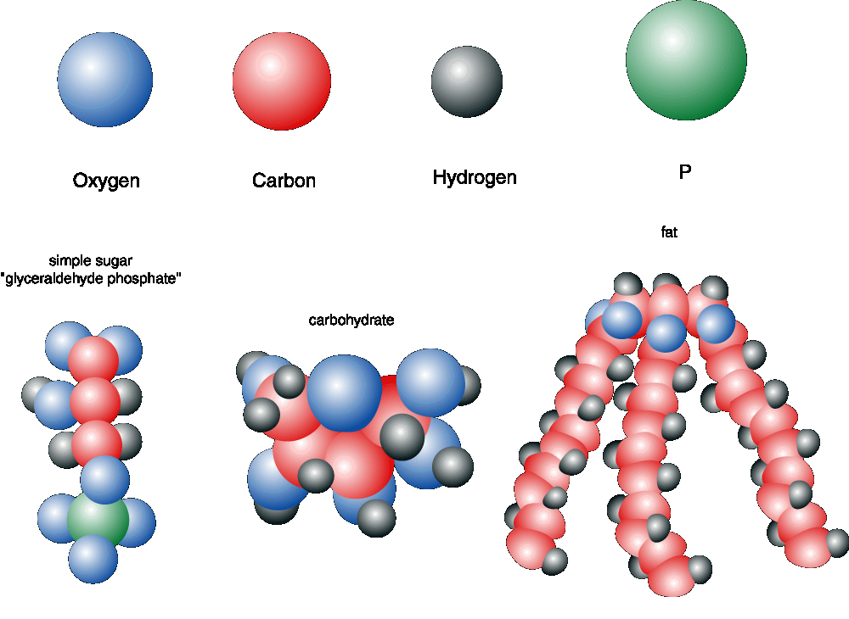
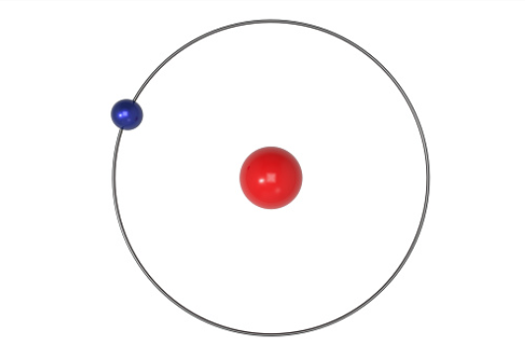
Diagnostic Imaging: MRI
1980s: First clinical MRI scanners
In MRI the signal comes from the patient/participant
Image courtesy of NASA, altered by speaker

Slide 13
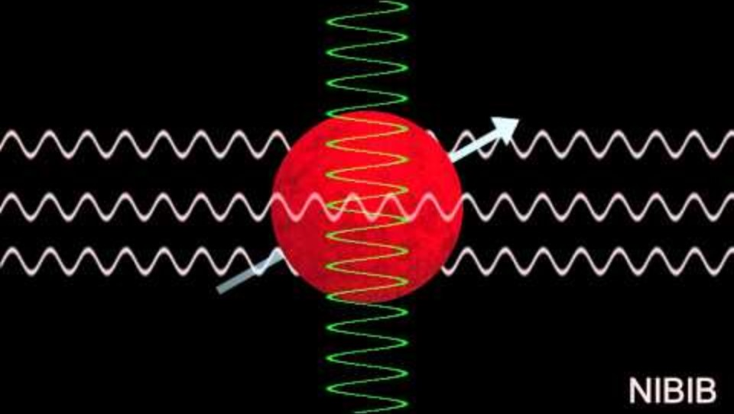
Diagnostic Imaging: MRI
MRI scanners use a main magnetic field, coils, and radiofrequency
You get signal that needs a lot of computation to be turned into something that you see in XYZ

Slide 14
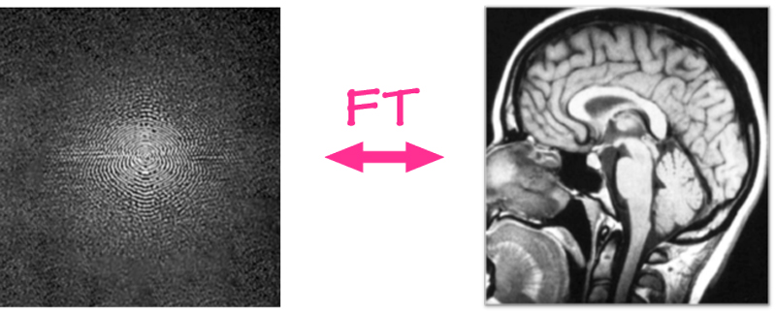
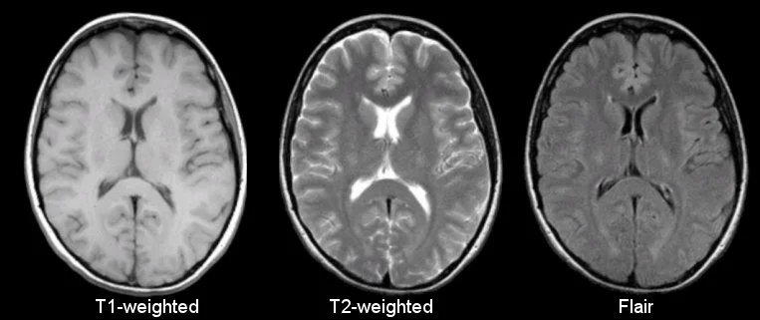
Diagnostic Imaging: sMRI sequences
Signal is influenced by settings and timings for RF pulses, gradients
Signal capture (can be based on magnetic properties, number, Brownian motion…).
Fourier Transform
K space signal -> processing/computation -> human readable images
K-space = raw data of spatial frequences in a matrix

Slide 15
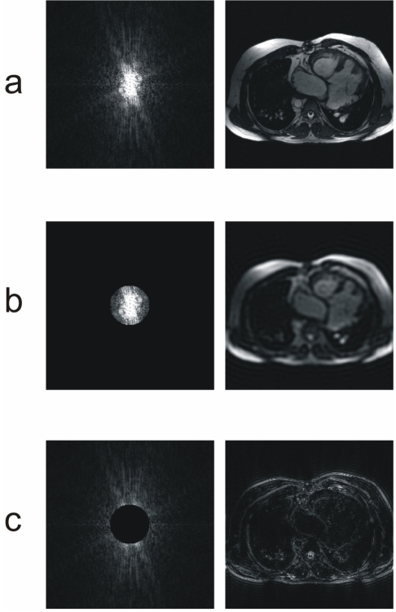
Diagnostic Imaging: sMRI sequences
.
Filtering as done on the k-space
D Moratal, A Vallés-Luch and L Martí-Bonmatí et al. k-Space tutorial: an MRI educational tool for a better understanding of k-space. Biomedical Imaging and Intervention Journal. 2008. Vol. 4(1). DOI: 10.2349/biij.4.1.e15
Notes:
a. Unfiltered b. low pass filtering c. high pass filtering

Slide 16
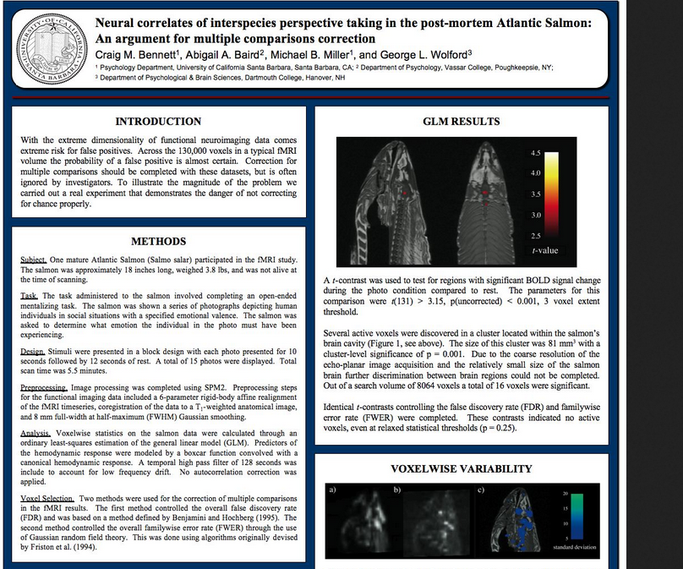
Diagnostic Imaging: other MRI
Emerging sequences: ASL, connectomes (DTI + tractography)
Functional MRI: look at activity BOLD
Emerging sequences -> a lot undecided on computation, even where in DICOM
Spectroscopy: metabolites/chemicals by peaks, not a true image

Slide 17
Diagnostic Imaging: MRI?
Advantages:
better soft tissue differentiation than CT
radiation free
Disadvantages:
time consuming, can patient stay still? (tremor, anxiety, age, peristalsis etc.)
money consuming
Spin echo sequences have consolidated names T1, T2, PD, also IR sequences (FLAIR)
Newer technologies/sequences are a vendor created chaos of terminology
Computationally spin echo sequences very similar to CT, 3D arrays and in DICOM metadata. Other sequences can be higher dimensional arrays.
Multiple file formats proliferate e.g. NiFTi, Minc (also multimodal), etc.
Notes:
Example: a balanced gradient echo has 5 different names b/c manufacturers i.e. Philips, Siemans, Toshiba, GE, Hitashu

Slide 18
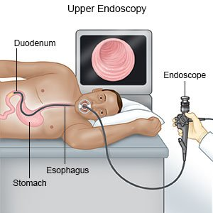
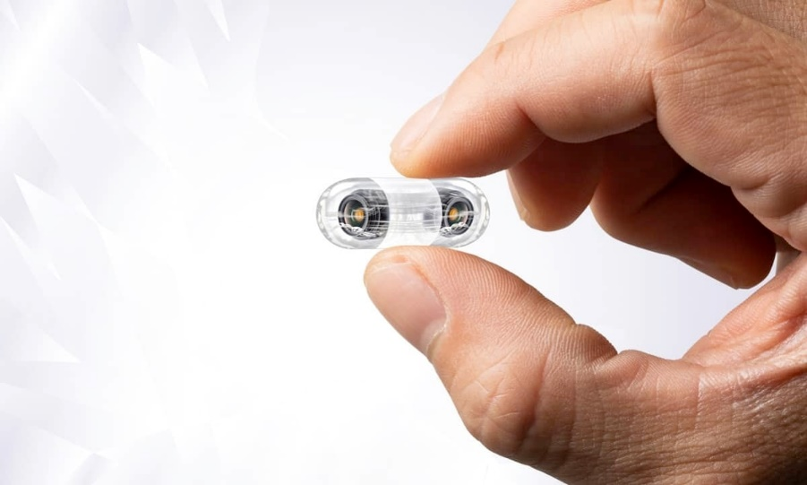
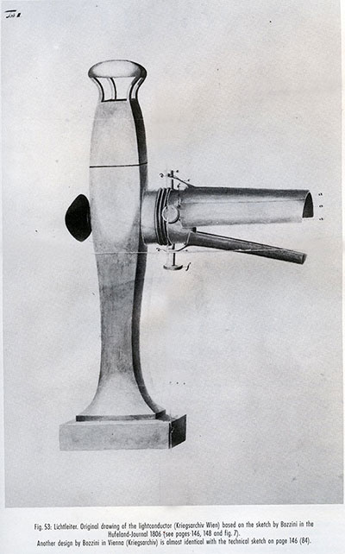
Diagnostic imaging: Endoscopy
1806, Bozzini demonstrated his Lichtleiter on living patients
The main requirements for looking into the internal cavities of the living body are therefore: I. To introduce a sufficient amount of light into these cavities. II. To bring the reflecting light-rays back to the eye of the examiner. To fulfill the first requirement you need a) a physiological or pathological orifice b) a light container c) light conducting tubes To fulfill the second requirement you need an additional tube for the reflecting the light rays – which I call for the sake of distinction – reflecting tube. Excerpt: Philipp Bozzini’s “Lichtleiter, eine Erfindung zur Anschauung innerer Theile und Krankheiten”, in Journal der praktischen Heilkunde, Berlin 1806.
Don’t worry, multiframe video in DICOM

Slide 19
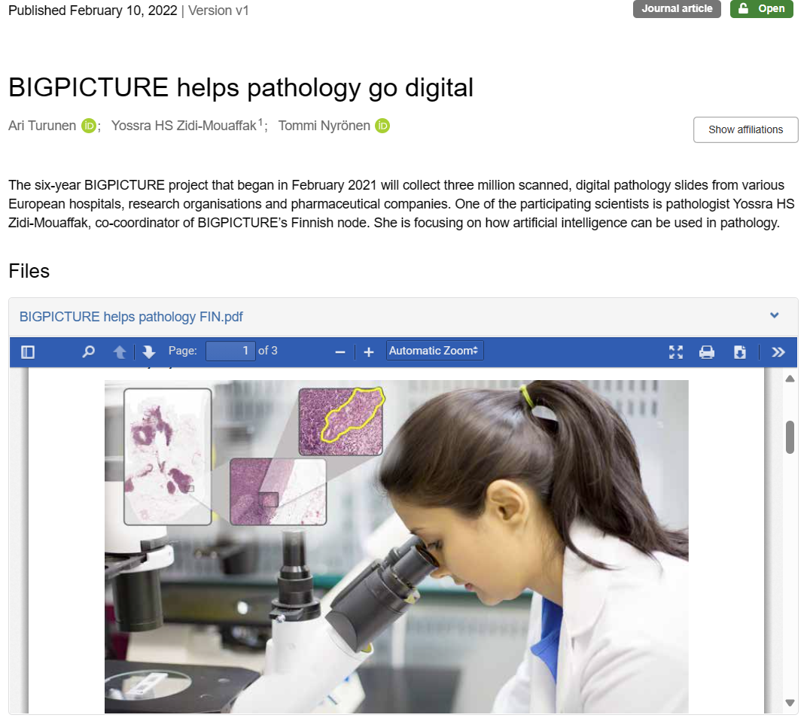
Diagnostic imaging: Microscopy → Pathology
Stains: H+E, Van Glieson, Toloudine Blue, Alcian Blue, Giemsa, Reticulin, Nissl….Immuno flourescence tagging
digital microscopy, digital photography

Slide 20
Diagnostic imaging: Pathology
For digital pathology slides put on various scanners
Scanners determine the original file format (mrxs, DICOM, svslide etc.) and some characteristics (magnification)
Computational issues: very analog field, variety of file formats→ conversion
TIFFs unsurprisingly popular (cloud optimized)
Standardizing force is OME (open microscopy environment) → OME-TIFF (xml metadata); OME-NGFF as next generation?
Bioformats library (python wrapped Java), Openslide (python wrapped C)

Slide 21
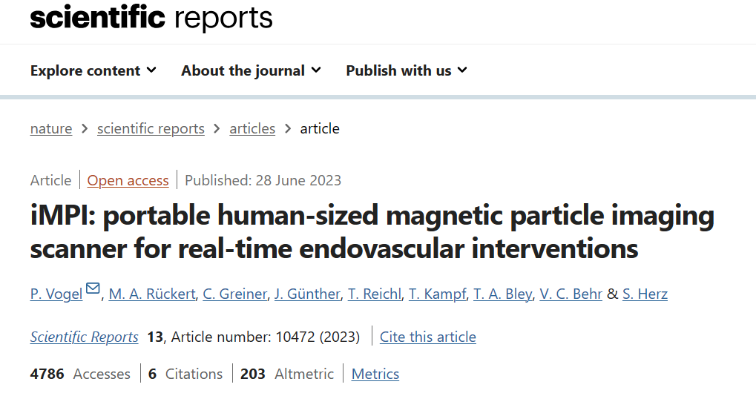
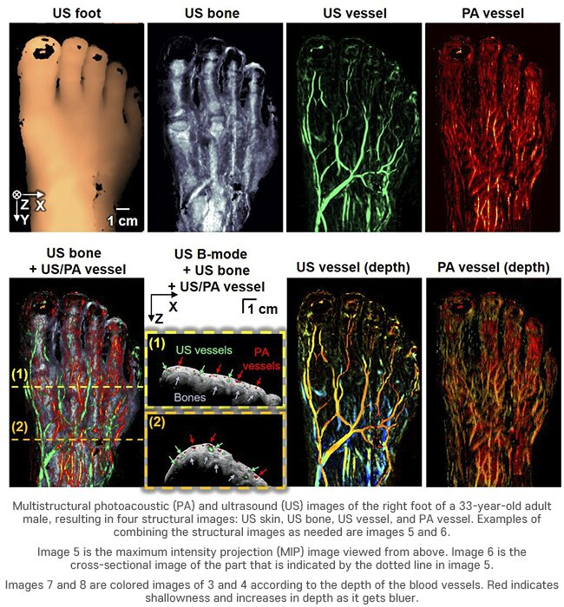
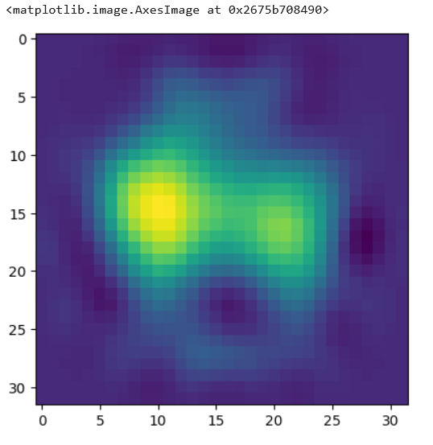
Diagnostic imaging: Emerging modalities
Adding more and the exceptions:
Magnetic particle imaging
Photoacoustic imaging
electrical impedance tomography
And more to come
Credit: Pohang U. Science and Technology

Slide 22
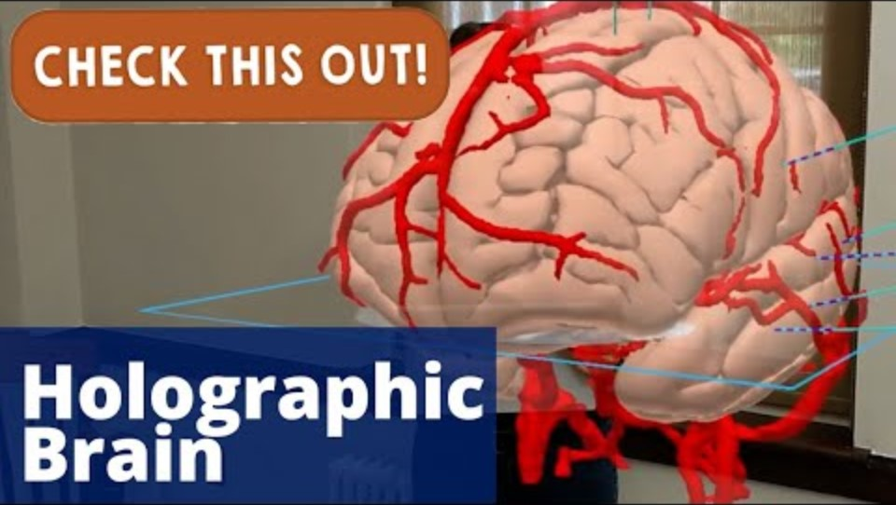
Diagnostic imaging: Visualization
Visualization technologies:
slices → 3D rendering , printing, VR/XR and beyond
Ray casting/tracing and possibilities may explore with ‘hardware Cambrian explosion’

Slide 23
Take home – a table approach:
example- fetal macrocephaly
Imaging type | Signal | File | Image inside | Image array | Image | Notes
X-ray | Ionizing radiation + | DICOM | Typically JPEG 2000 (can be lossless ) | 2D arrays | Summation of all attenuations | Summation of all attenuations
Fluoroscopy | Ionizing radiation ++ | DICOM | MPEG or HEVC | 4D tensor ( frames, height, width, channels) | Summation of all attenuations over many time points | Summation of all attenuations but now in sequence
CT | Ionizing radiation +++ | DICOM | Raw voxel data or compressed | 3D array | Anatomically correct slices | Axial acquisition
B-mode ultrasound + Doppler | Soundwaves | DICOM | CINE | 4D tensor + extras or 2D arrays | Plane with some distortion + doppler movement | Not good with air, Sees across a plane
M-Mode | Soundwaves | DICOM | CINE | 4D tensor + extras | Single line scan image | User dependant, no radiation, captures motion
Digital microscopy | Light on stained tissue | Multiple | Often converted to TIFF | 2D multichannel arrays, (3D arrays) | Subcellular level resolution | Stains can show chemicals on cellular level
MRI T1, T2, T2* etc. | Patient’s molecules | DICOM* | Raw voxel data or compressed: | 3D array | K-space -> our image w/ highest soft tissue differentiation | Not great with bone

Slide 24
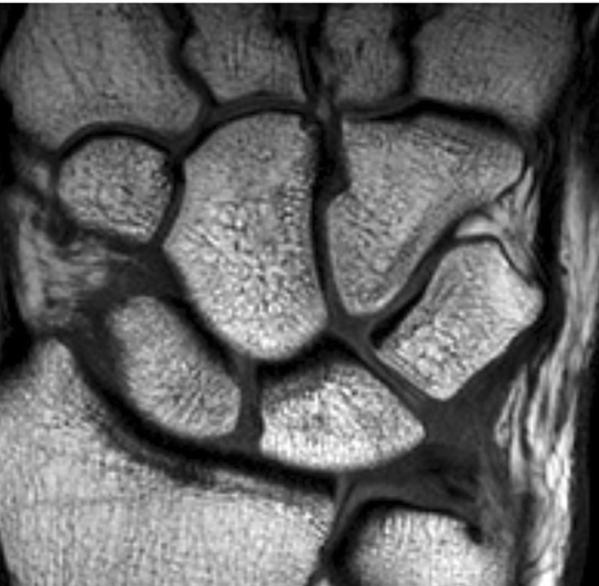
Diagnostic imaging: 129 years in…towards 1686?

Slide 25
Diagnostic imaging: Final points
The big bang continues….
Digitalization means everything will be computational
Newer technologies not solidified in standards: DICOM, names
Every type and sequence gives you different and more information
Currently many images are often not that ‘specific’, but they are surrounded by other data
--------------
Don’t fear other modalities, it’s all arrays

